Slide 1
Untangling the Cloud from Edge Computing for IoT
Nabeel Nasir
Advised by: Prof. Bradford Campbell

Slide 2
By 2025
55 Billion IoT Devices
73 Zettabytes of Data
Source: International Data Corporation (IDC)

Slide 3
Edge Computing to Handle Massive Influx of IoT Data
Cloud
Edge Server
Gateways
Devices
Notes:
ec is one solution which prescribes a tiered architecture
you have devices at the bottom most layer
you have gateways - devices like raspberry pis - which has wireless radios to communicate with devices
the central piece is an edge server within your local network, which runs applications, without depending on the cloud
but the cloud is used as the control plane for orchestration and configuration

Slide 4
Cloud and Edge Server Dependence an Obstacle
“Off-grid” usage
Cloud and bandwidth costs
Scalability
Access to a server
Limited Privacy Controls
Cloud
Edge Server
Gateways
Devices
Notes:
there are some issues with this architecture
relying on the cloud is impractical in some use cases where there is no internet connection, like a remote deployment with no access, or in a secure deployment like a hospital where cloud access is not preferred
there are some cloud and bandwidth costs involved
requiring prior configuration at the cloud hinders scalability
another key assumption is that every deployment will have access to an edge server, which is extremely unrealistic for most use cases
also all data from a deployment is usually treated as owned by a single entity, with no transparency or privacy control for individuals

Slide 5
Leverage Gateways for Edge Computing
Cloud
Gateways indispensable for IoT
Increasingly capable
Relatively Inexpensive
Edge Server
Gateways
Devices
Notes:
Leverage Gateways for Edge Computing
Focus on the gateways
Show the two points
First point to enforce privacy

Slide 6
Key Ideas to Remedy Cloud & Edge Server Issues
Distributed Gateway Network instead of an Edge Server

Slide 7
Distributed Gateway Network Instead of Edge Server
Cloud
Edge Server
Gateways
Devices
Notes:
Cloud
Support responsive edge applications and cutting edge IoT devices using a distributed network of IoT gateways without requiring edge servers.
Comparison figure (with the server vs with the distributed gateways)

Slide 8
Shifting From an Edge Server Poses Some Challenges
Overheads with Decentralization
Easier application code with simple centralized model
No central point to manage platform
Scalability
Gateway configuration could pose overhead in scaling
Resource Constraints
Limited resources like storage, GPUs etc.
Resilience
Gateways not as sturdy as a server machine

Slide 9
Middleware on Gateways to Facilitate this Shift
Gateway discovery for scalability
Supports IoT device handling
Encapsulates network topology
Distributed services to handle devices, applications, and data streams
Device interaction API hides underlying network complexity from apps
Provides remote management
Application
&
Management
Layer
Platform
Layer
Hardware
Layer
Notes:
Briefly touch on lightweight containerization, and distributed storage

Slide 10
Key Ideas to Remedy Cloud & Edge Server Issues
Distributed Gateway Network instead of an Edge Server
Specialized Edge Hardware for Elasticity

Slide 11
Edge Gateways Becoming Increasingly Capable and Specialized
Substantially cheaper
Can match app requirements
Directly interact with IoT devices
Better deployment flexibility
Raspberry Pi
NVIDIA Jetson
Xavier NX
Google Coral
with Edge TPU
Notes:
https://developer.nvidia.com/embedded/jetson-xavier-nx-devkit
https://www.raspberrypi.com/products/raspberry-pi-4-model-b/
https://coral.ai/products/dev-board
Substantially cheaper than edge servers
Specialized hardware can match application requirements
Low-power wireless radios to interact directly with IoT devices
Increased deployment flexibility compared to servers

Slide 12
Utilize Specialized Edge Hardware for Elasticity
Scale out by adding a new gateway
Gateways
Schedule based on requirements
Devices
Notes:
Start small and add new hardware if needed to Scale out
- Use a distributed task scheduler to match application requirements with gateways capabilities to provide best available quality of service to applications.

Slide 13
Scheduler uses Requirements, Capabilities and Resource Usages

Slide 14
Scheduling the Key Challenge, and Different from Other Domains
Optimal scheduling algorithm based on
Application requirements
Gateway capabilities
Gateway resource usages
Different from Task Schedulers in other domains:
Grid Computing, Cluster Computing: Mostly homogeneous machines
Real-time scheduling: Requires execution times and deadlines
Function-as-a-Service Platforms: App’s requirements or machine’s capabilities not considered
Notes:
Add table

Slide 15
Key Ideas to Remedy Cloud & Edge Server Issues
Distributed Gateway Network instead of an Edge Server
Specialized Edge Hardware for Elasticity
Privacy Policies enforced on Gateways to empower Users

Slide 16
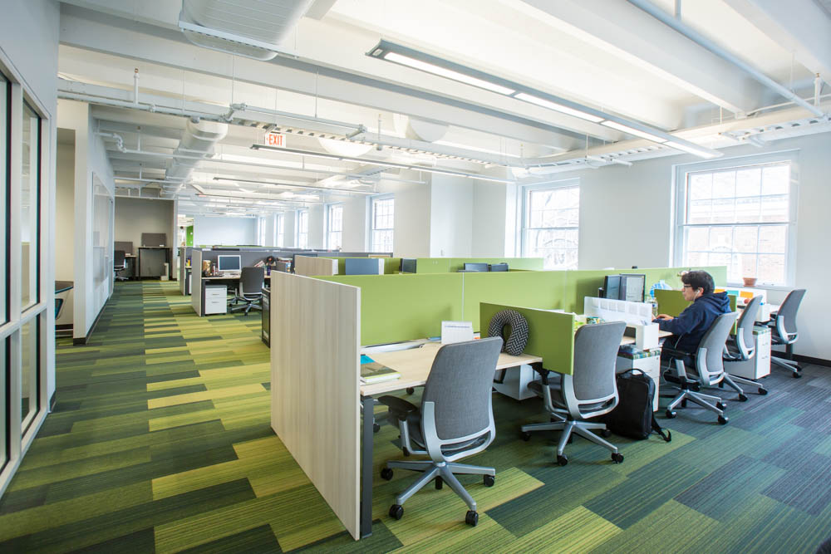
People in Shared Spaces have No Idea About Their Sensed Data
Notes:
In shared spaces, users have no idea about what's being sensed or which applications are using their data.
Empower users in shared spaces with collaborative privacy policies that operate closest to the devices to provide more transparency and better control of their data.

Slide 17
Utilize Existing Sensor Stream Service to Enforce Policies
T1
Middleware
Stream Manager
Middleware
Stream Manager
App
T2
Policy: Don’t share T1 with App
Middleware
Stream Manager

Slide 18
T1
Middleware
Stream Manager
Middleware
Stream Manager
App
T2
Gateway 1
Gateway 3
Middleware
Stream Manager
Gateway 2

Slide 19
User-driven Privacy Policies to Empower People
Users can specify policies like:
Allow access to occupancy data to all apps, but only from 9AM – 5PM
Share occupancy data to an emergency evacuation app, but not to room scheduling app
Challenge:
Simple user interface to convey this complex information
Novelty:
Some privacy policy works exist, but novel way of policy enforcement

Slide 20
Conclusion
Democratize Edge Computing by untangling it from cloud and edge server dependencies
Utilize inexpensive gateway network to execute applications
Empower users by providing transparency and control over data

Slide 21
Thank you!
Questions?
You can find me on:
Website: http://www.virginia.edu/~nn5rh
Email: nabeeln@virginia.edu
LinkedIn: https://www.linkedin.com/in/nabeel-nasir/
I am seeking summer internship opportunities!

